Slide 1
Big Mountain Resort Ticket Price

Slide 2
What is holding back revenue?
Big Mountain resort is looking for a way to have a data-driven business strategy. There has been a recent installment of a new chair lift. This means less wait time for customers. There being no data driven business strategy gives many price factors up to intuition. This shows that Big Mountain Resorts luxury comedies may be undervalued.

Slide 3
Solution
The price of $81 per ticket was off $14 dollars of the recommend price of $95. This is a 17 % suggested increase. The price increase was not the only way to increase revenue suggested by the modeling. The second was to increase vertical drop by 150 feet, add one run, and add one chair(already done) for a suggested price increase of $1.99. This would mean a total revenue increase of $3,474,368 per season. These changes can be implemented in the upcoming season to test results. The biggest factor in possible revenue loss is closing more than 5 runs. Highly suggested against closing more than 1 run.

Slide 4
Big Mountain Resorts Edge
Most runs Montana
Night skiing
The amount of acres covered with snow makers(guaranteed opened)
Low competition (possible competitive monopoly)

Slide 5
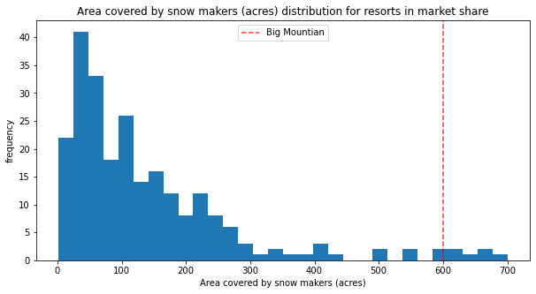
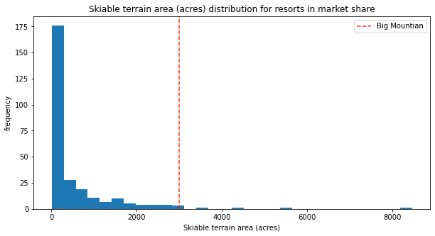
Data

Slide 6
Why not other scenarios?
The other scenarios looked at involved closing runs,increasing snow coverage , and increasing length of longest run. The model suggested that when decreasing runs, there were two drop offs of price. One being when you closed 2-3 runs the next being when you closed 6- 10. This would mean a loss in revenue by a high margin. The next scenario of increase length of a run and snow coverage came back with a zero increase in revenue. The only scenario that gave a reason for price increase was increasing run amount, chairs , and vertical drop. These all are important factors to price.

Slide 7
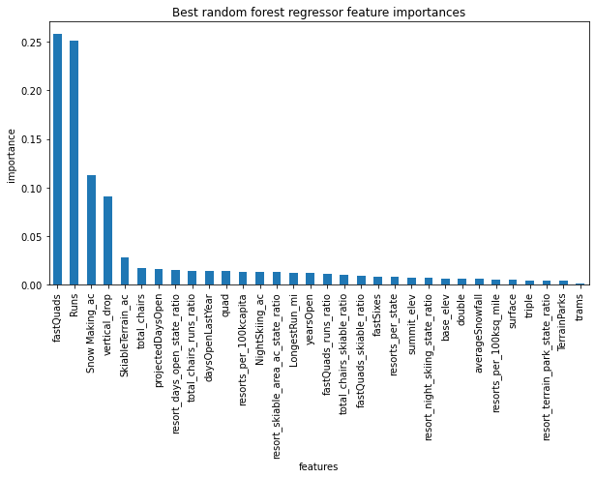
Most Important Factors

Slide 8
Conclusion
In all the data suggest a price increase of up to 17% this upcoming season. It also shows that in the future increase runs and vertical drop will allow for another price increase of $1.99. The recommend price is $95 but beware of jumping up immediately because of error margin of around $10. Beyond this it is recommend to increase price by your digression up to that $95.

